Slide 1

React
#1 Learn Once, Write Anywhere

Slide 2

React is a declarative, efficient, and flexible JavaScript library for building dynamic user interfaces.
React is maintained by Facebook, Instagram & lot of developers community around the globe (it’s open source!)
More informations: https://reactjs.org

Slide 3
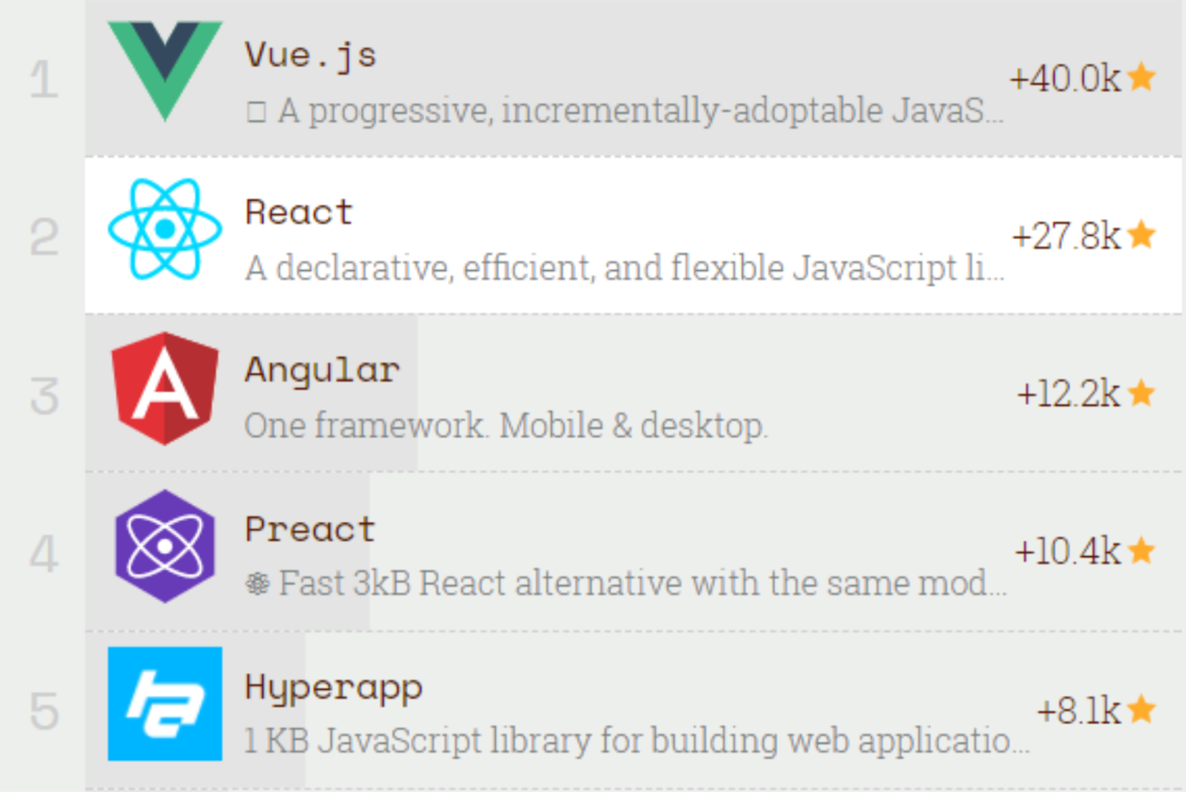
Top JS Front–End Frameworks 2017
https://risingstars.js.org/2017/en/

Slide 4
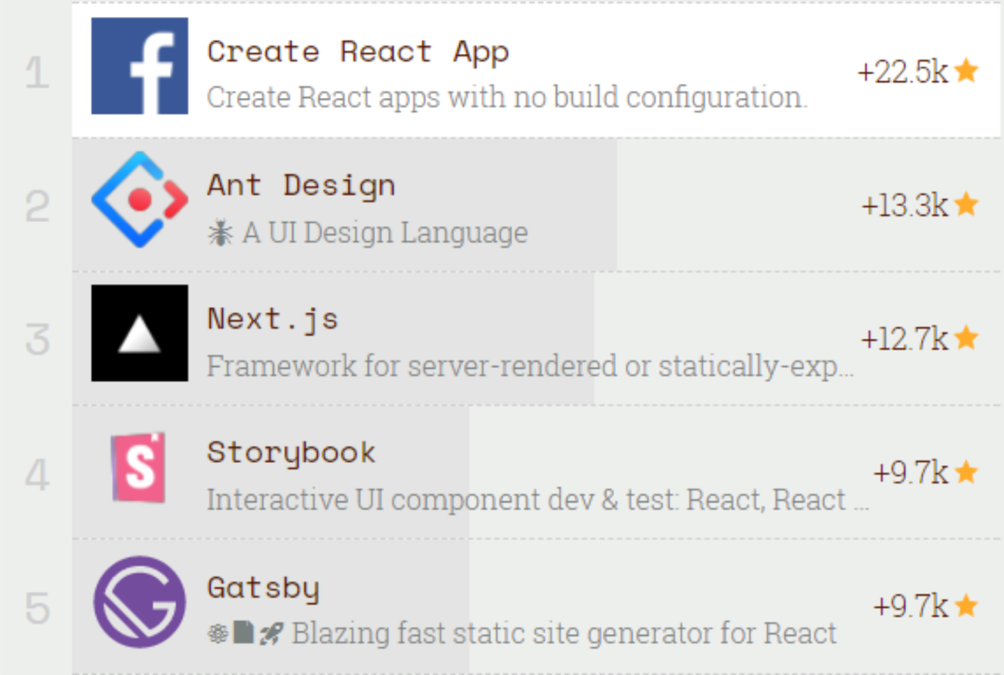
Top React Ecosystem 2017
https://risingstars.js.org/2017/en/

Slide 5

Advantages
Design simple declarative views for each state in an application.
Encapsulated components.
Dynamics properties & state.
Light & faster virtual DOM.
Independent of the rest of application.
Can render on client or server.

Slide 6
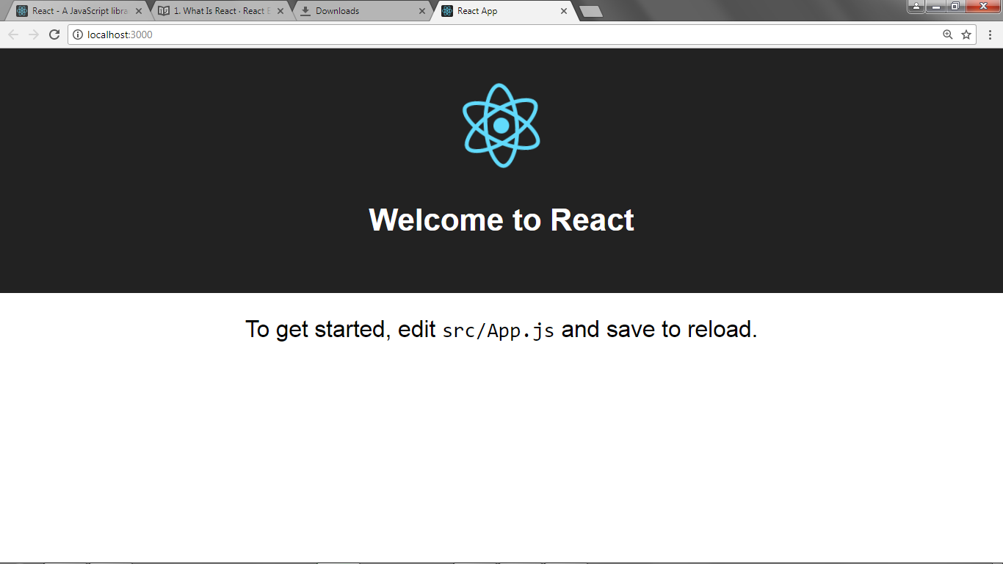
Setup
Open terminal, on project directory type:
$ npm install –g create-react-app
$ create-react-app <namaProject>
$ cd <namaProject>
$ npm start

Slide 7
Take a look!
public/index.html
<!DOCTYPE html>
<html lang="en">
<head>
<meta charset="utf-8">
<meta name="viewport" content="width=device-width,
initial-scale=1, shrink-to-fit=no">
<meta name="theme-color" content="#000000">
<link rel="manifest" href="%PUBLIC_URL%/
manifest.json">
<link rel="shortcut icon" href="%PUBLIC_URL%/
favicon.ico">
<title>React App</title>
</head>
<body>
<noscript>
You need to enable JavaScript to run this app.
</noscript>
<div id="root"></div>
</body>
</html>

Slide 8
Take a look!
src/index.js
import React from 'react';
import ReactDOM from 'react-dom';
import './index.css';
import App from './App';
import registerServiceWorker from
'./registerServiceWorker';
ReactDOM.render(<App />,
document.getElementById('root'));
registerServiceWorker();

Slide 9
import React, { Component } from 'react';
import logo from './logo.svg';
import './App.css';
class App extends Component {
render() {
return (
<div className="App">
<header className="App-header">
<img src={logo} className="App-logo" alt="logo" />
<h1 className="App-title">Welcome to React</h1>
</header>
<p className="App-intro">
To get started, edit <code>src/App.js</code>
and save to reload.
</p>
</div>
);
}
}
export default App;
Take a look!
src/App.js

Slide 10
src
src/App.js
src/index.js
public/
Index.html

Slide 11
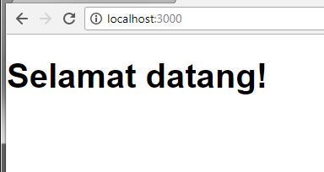
src/App.js
Components
import React, { Component } from 'react';
class App extends Component {
render() {
return (
<h1>Selamat datang!</h1>
);
}
}
export default App;

Slide 12
src/App.js
Components
import React, { Component } from 'react';
class App extends Component {
render() {
return (
<h1>Selamat datang!</h1>
);
}
}
export default App;
Component
JSX
JSX is an XML/HTML-like syntax used by React that extends ECMAScript so that XML/HTML-like text can co-exist with JavaScript/React code.

Slide 13
JSX
JSX is a syntax extension to JavaScript, that produces React “elements”.
React doesn’t require using JSX, but most people find it helpful as a visual aid when working with UI inside the JavaScript code.

Slide 14
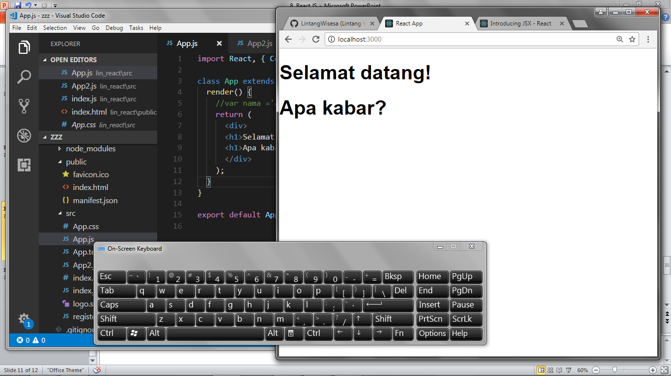
src/App.js
Components
Return render on a Component must be only one tag parent!
import React, { Component } from 'react';
class App extends Component {
render() {
return (
<div>
<h1>Selamat datang!</h1>
<h1>Apa kabar?</h1>
</div>
);
}
} export default App;

Slide 15
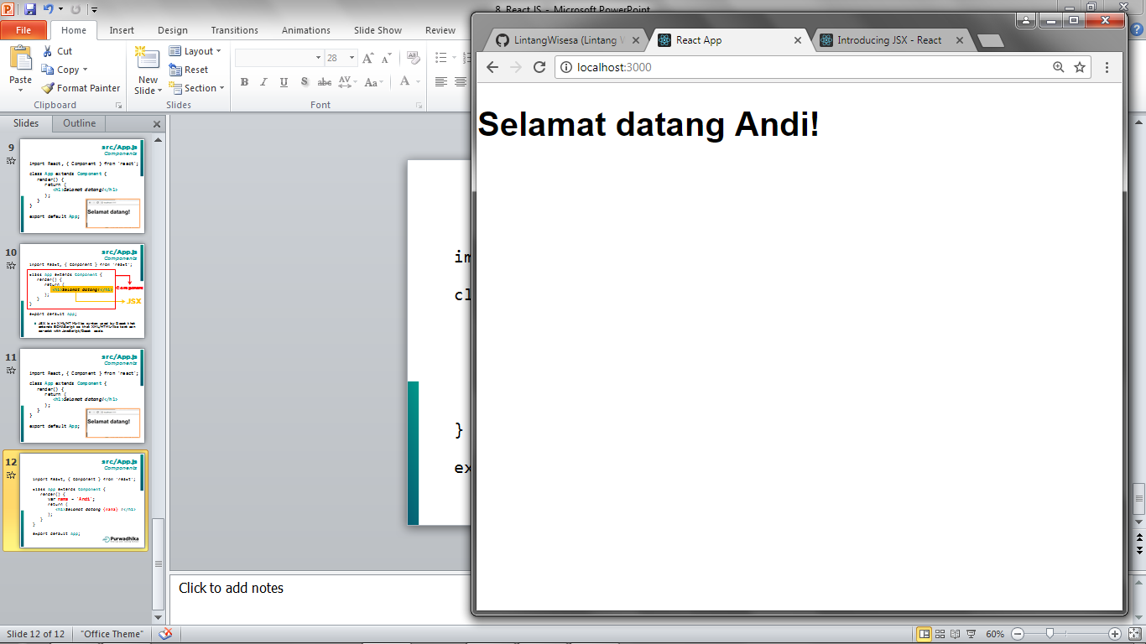
src/App.js
JSX Insert var
import React, { Component } from 'react';
class App extends Component {
render() {
var nama = 'Andi';
return (
<h1>Selamat datang {nama} !</h1>
);
}
}
export default App;

Slide 16
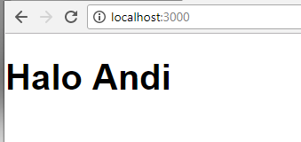
src/App.js
JSX constructor
import React, { Component } from 'react'; class App extends Component {
constructor(){
super();
this.nama = 'Andi';
}
render() {
return (
<h1>Halo {this.nama}</h1>
);
}
} export default App;

Slide 17
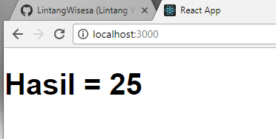
src/App.js
JSX Insert function
import React, { Component } from 'react';
class App extends Component {
hitung(x){
return x*x;
};
render() {
return (
<h1>Hasil = {this.hitung(5)}</h1>
);
}
}
export default App;

Slide 18
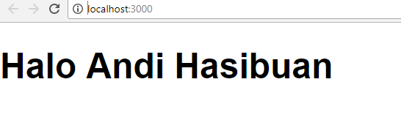
src/App.js
Embedding Expressions
import React, { Component } from 'react'; class App extends Component {
render() {
function namaFull(id) {
return id.nama + ' ' + id.marga;
}
const id = {
nama: 'Andi',
marga: 'Hasibuan'
};
return (
<h1>Halo {namaFull(id)}</h1>
);
}
} export default App;

Slide 19
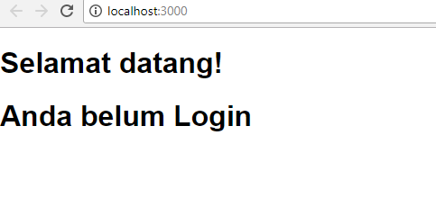
src/App.js
Conditional Rendering
import React, { Component } from 'react';
class App extends Component {
render() {
function login(x) {
const udahLogIn = x;
if (udahLogIn) {
return 'Anda sudah Login';
}
return 'Anda belum Login';
}
return (
<div>
<h1>Selamat datang!</h1>
<h1>{login(false)}</h1>
</div>
);
}
}
export default App;

Slide 20
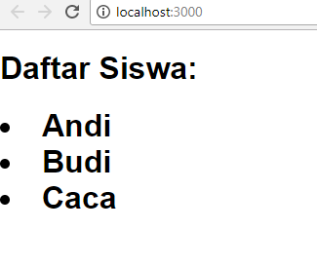
src/App.js
Rendering Multiple Components
import React, { Component } from 'react';
class App extends Component {
render() {
const siswa = ['Andi','Budi','Caca'];
const listSiswa = siswa.map((siswa) =>
<li>{siswa}</li>
);
return (
<div>
<h1>Daftar Siswa:</h1>
<ul><h1>{listSiswa}</h1></ul>
</div>
);
}
}
export default App;

Slide 21
Keys help React identify which items have changed, are added, or are removed. Keys should be given to the elements inside the array to give the elements a stable identity.
src/App.js
Keys
import React, { Component } from 'react';
class App extends Component {
render() {
const siswa = ['Andi','Budi','Caca'];
const listSiswa = siswa.map((siswa, index)=>
<li key={index}>{siswa}</li>
);
return (
<div>
<h1>Daftar Siswa:</h1>
<ul><h1>{listSiswa}</h1></ul>
</div>
);
}
}
export default App;

Slide 22
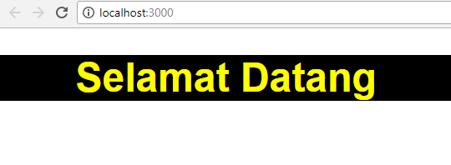
src/App.js
JSX Inline CSS #1
import React, { Component } from 'react';
class App extends Component {
render() {
return (
<div style={{color:'yellow',background:'black'}}>
<center>
<h1>Selamat Datang</h1>
</center>
</div>
);
}
}
export default App;

Slide 23
src/App.js
JSX Inline CSS #2
import React, { Component } from 'react'; class App extends Component {
render() {
var styles = {
color:'yellow',
background:'black',
};
return (
<div style={styles}>
<center>
<h1>Selamat Datang</h1>
</center>
</div>
);
}
} export default App;

Slide 24
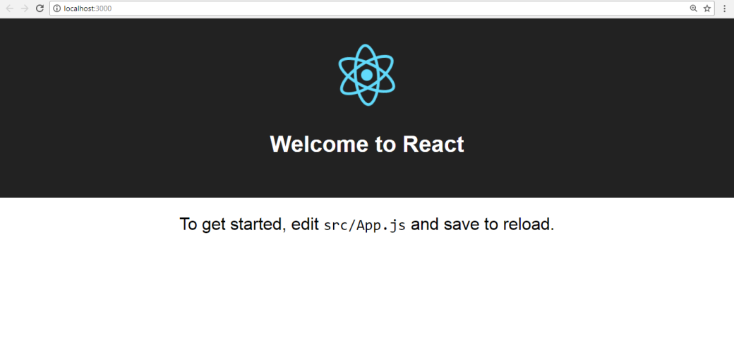
component
src/App.js
Header.js
src
Footer.js
src/index.js
public/
Index.html

Slide 25
src/component/Header.js
import React, { Component } from 'react';
class Header extends Component {
render() {
return (
<div>
<ul>
<li>Beranda</li>
<li>Tentang</li>
<li>Kontak</li>
</ul>
</div>
);
}
} export default Header;

Slide 26
src/component/Footer.js
import React, { Component } from 'react';
class Footer extends Component {
render() {
return (
<div>
<h4>Buatan saya @ 2018</h4>
</div>
);
}
} export default Footer;

Slide 27
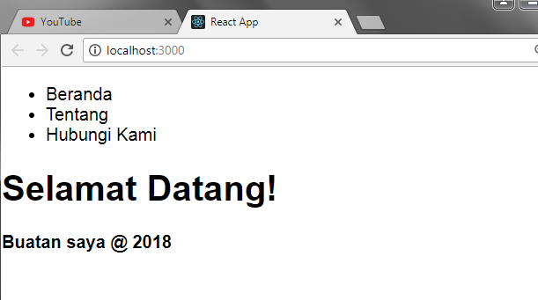
import React, { Component } from 'react';
import Header from './component/Header';
import Footer from './component/Footer';
class App extends Component {
render() {
return (
<div>
<Header />
<h1>Selamat Datang!</h1>
<Footer />
</div>
);
}
} export default App;
src/App.js

Slide 28

style
component
src/App.js
Header.css
Header.js
src
Footer.css
Footer.js
src/index.js
public/
Index.html

Slide 29
src/style/Header.css
.Header{
background-color: pink;
text-align: center
}
.ul_Header{
color: blue
}

Slide 30
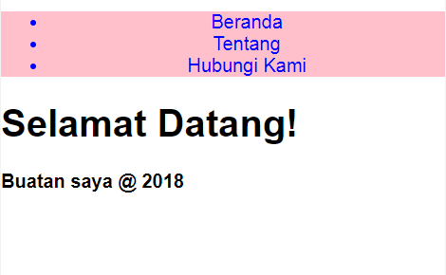
src/component/Header.js
import React, { Component } from 'react';
import './../style/Header.css';
class Header extends Component {
render() {
return (
<div className="Header">
<ul className="ul_Header">
<li>Beranda</li>
<li>Tentang</li>
<li>Kontak</li>
</ul>
</div>
);
}
} export default Header;

Slide 31


Adding Bootstrap
style
component
src/App.js
Header.css
Header.js
src
Footer.css
Footer.js
src/index.js
public/
Index.html

Slide 32
public/index.html
<!DOCTYPE html>
<html lang="en">
<head>
<meta charset="utf-8">
<meta name="viewport" content="width=device-width,
initial-scale=1, shrink-to-fit=no">
<meta name="theme-color" content="#000000">
<link rel="manifest" href="%PUBLIC_URL%/
manifest.json">
<link rel="shortcut icon" href="%PUBLIC_URL%/
favicon.ico">
<insert jQuery & Bootstrap
CDN link here!>
<title>React App</title>
</head>

Slide 33
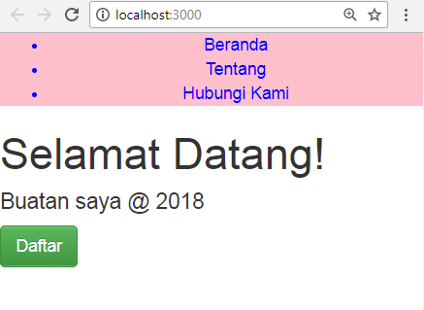
src/component/Footer.js
import React, { Component } from 'react';
class Footer extends Component {
render() {
return (
<div>
<h4>Buatan saya @ 2018</h4>
<button className="btn btn-success">
Daftar
</button>
</div>
);
}
} export default Footer;

Slide 34
React
#1 Learn Once, Write Anywhere

